Slide 1

Unit 6: Risk Management Framework
By Desmond Hughes

Slide 2


Conducting A Risk Assessment
Helps control security, and handles vulnerabilities and defects, so that it stops threats for affecting the software or data and prevent security failures.

Slide 3
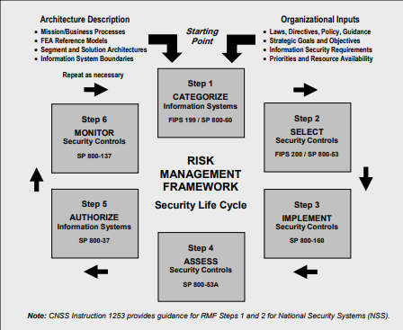
Risk Management Framework Chart
National Institute of Standards and Technology. (2020, September)

Slide 4

Step 1: Categorize
You will need to categorize the information and systems, and doing so will provide an accurate risk assessment

Slide 5

Step 2: Select
You would then need to select security controls based on the categorization.

Slide 6

Step 3: Implement
For the security controls you selected and put them in a document of the steps so that you have details for the operations

Slide 7

Step 4: Assess
Check the security control to make sure they are inputted, so that there are no risk to your data

Slide 8

Step 5: Authorize
Control on the system are authorized, that mean that the security controls are working correctly.

Slide 9

Step 6: Monitor
Monitor the security controls, so they continue to work efficiently, and make changes if needed

Slide 10

Businesses & Tiers
It is very beneficial for business to separate into tiers, because with each tier it will have its own infrastructure, so that the focus stays on a certain thing.

Slide 11

Advantages
Identifies the risk
Minimizes the security threats
Helps create awareness
Improve business processes
Give the business an upper hand against attacks

Slide 12
References
National Institute of Standards and Technology. (2020, September). Security and privacy controls for information systems and organizations. NIST Special Publication 800-53. https://nvlpubs.nist.gov/nistpubs/SpecialPublications/NIST.SP.800-53r5.pdf

